Slide 1
4COSCO11C.2 Web Design and Development
HTML Images, Links and Special Characters
CSS for Links, Images, CSS positioning
Week 3

Slide 2
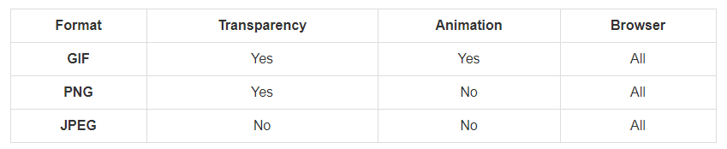
Images
Image Formats
Web browsers support the following image formats:

Slide 3
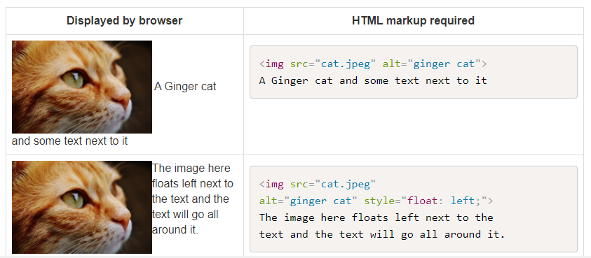
Insertion of in-line images

Slide 4
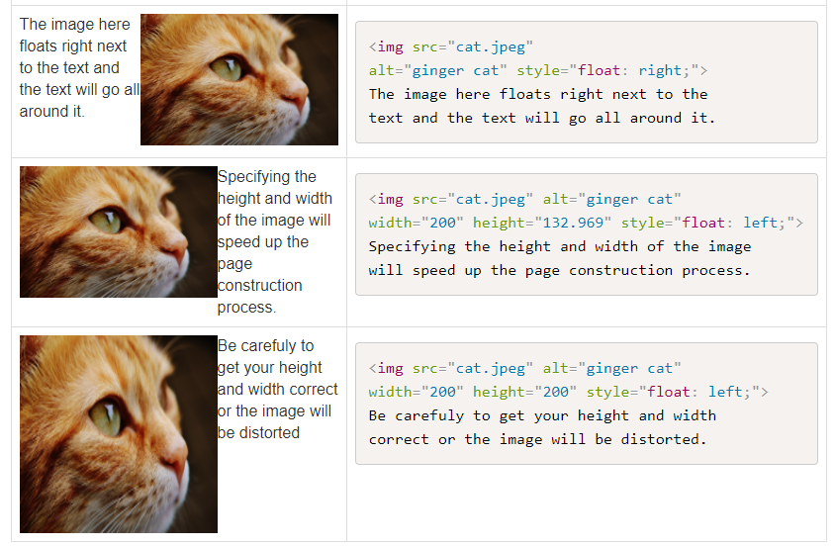
Contd..

Slide 5
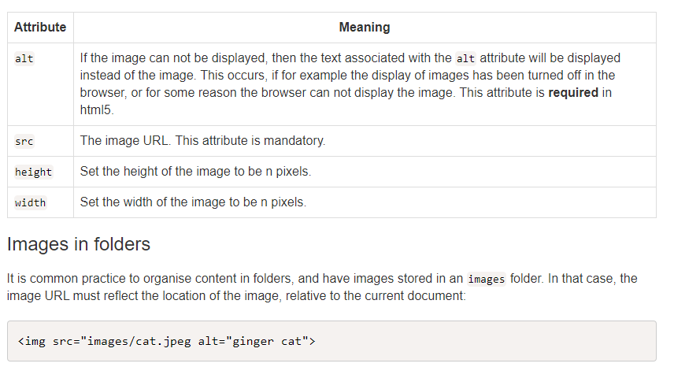
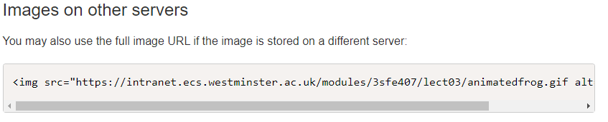
Image Attributes & folders

Slide 6
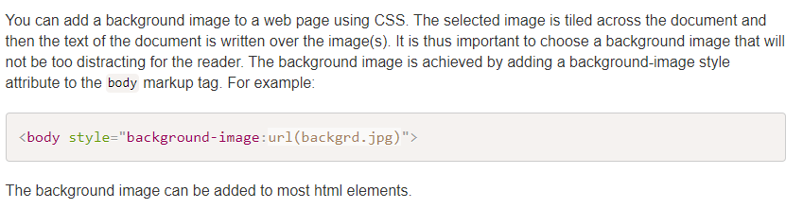
Adding Background image

Slide 7
Image Maps
An image map is an image with clickable areas.
Image maps are defined using the <map></map> tags, and each clickable area is defined using the <area> tag.
Finally, the image is displayed using the usual <img tag, and a name reference to the image map:
Click here

Slide 8
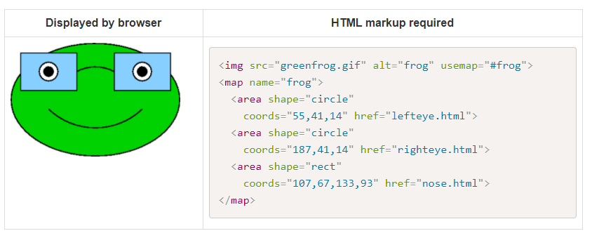
Image Maps

Slide 9
Review Questions
Question 1 - Which HTML tags is used to display an image?
Question 2 - What are the required attributes to the image tag?
Question 3 - What are the optional attributes to the image tag?
Question 4 - What is an image map?
Question 5 - How does one declare an image map?

Slide 10
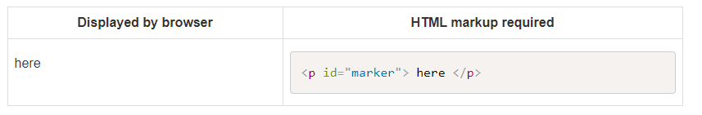
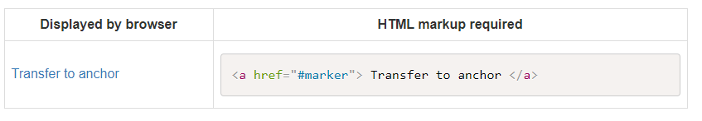
Links
Hypertext links
A hyper text link allows a browser of the document to navigate either:
to a new point in the document or to navigate to a different document.
A named point in a document is specified with the attribute ID. For example:
To effect a transfer to a named anchor point, the HREF form of the anchor tag is used. For example:

Slide 11
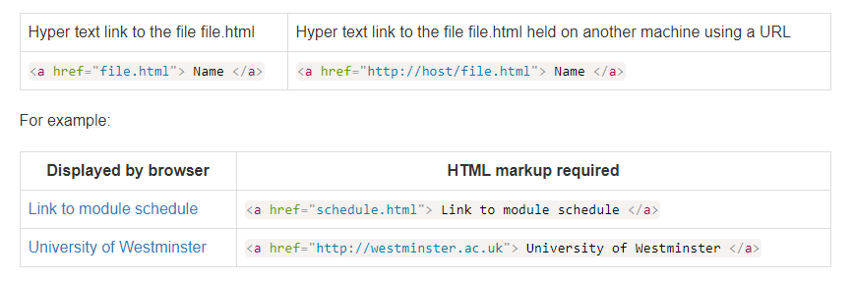
Links
Hypertext links may also link to other documents, in which case the href component names the document.
If the file is held on another machine then a URL (Uniform Resource Locator) is used to describe the location of the document. For example:

Slide 12
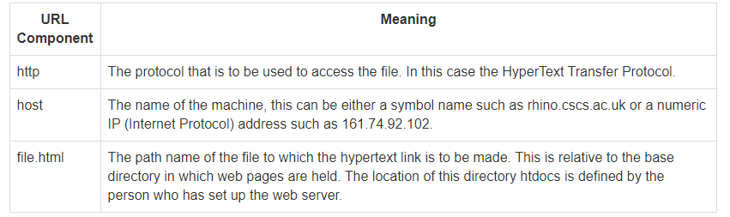
URL (Uniform Resource Locator)
The URL is used to specify the location of a file held on a remote machine.
This is composed of several distinct components. For example, the URL http://host/file.html is composed of the following components.

Slide 13
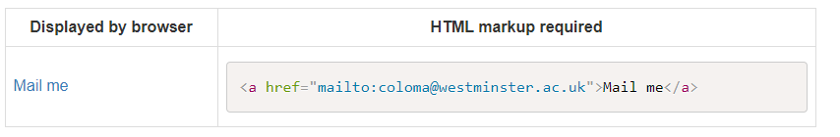
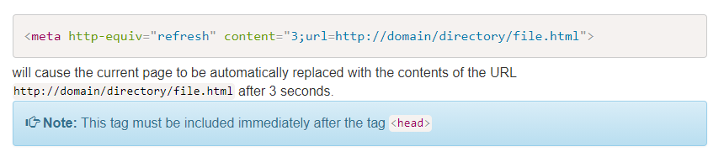
Links Contd
Inserting an e-mail address
Automatic redirect- A page may contain a tag that will cause an automatic redirection to another URL after a specific time interval. For example, the tag

Slide 14
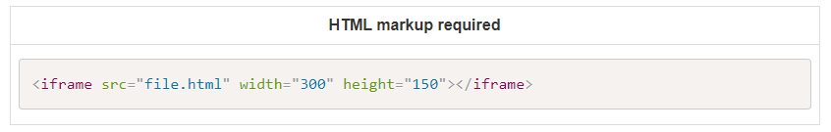
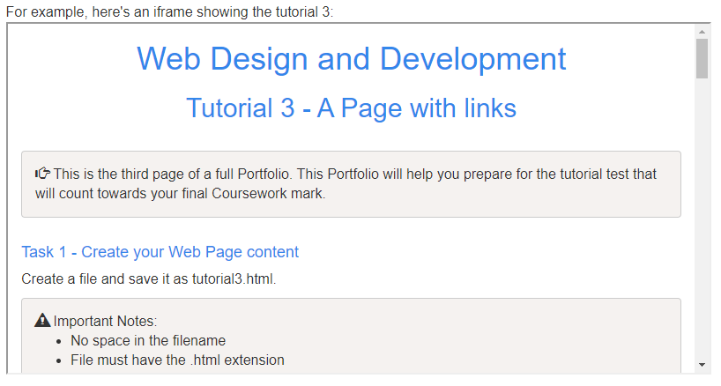
IFrames
An iFrame is used to display a Web page within another Web page.

Slide 15
Review Questions
Question 1 - Write the HTML for a link to scroll to the paragraph with the id=myId?
Question 2 - Write the HTML for a link to the email address w1234567@my.westminster.ac.uk
Question 3 - Write the HTML to add an automatic redirect to http://westminster.ac.uk after 2s

Slide 16
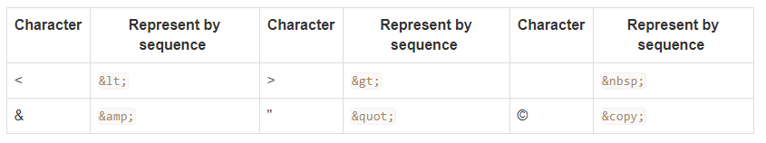
HTML Special Characters
The markup language uses the character < to start a markup tag.
The consequence of this is that < can not be used to represent the less than character directly in a web page.
The HTML markup languages defines an escape sequences of characters to represent such special characters.
The following are some of the character sequences used to represent characters that have a special meaning in the HTML language.

Slide 17
Review Questions
Question 1 - What is the sequence for a non breakable space?
Question 2 - Write the HTML to display <br> on a web page

Slide 18
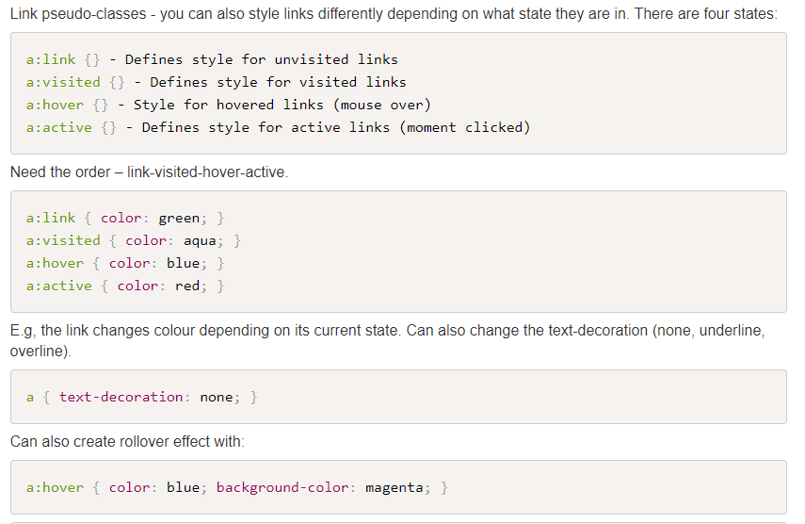
Styling Links

Slide 19
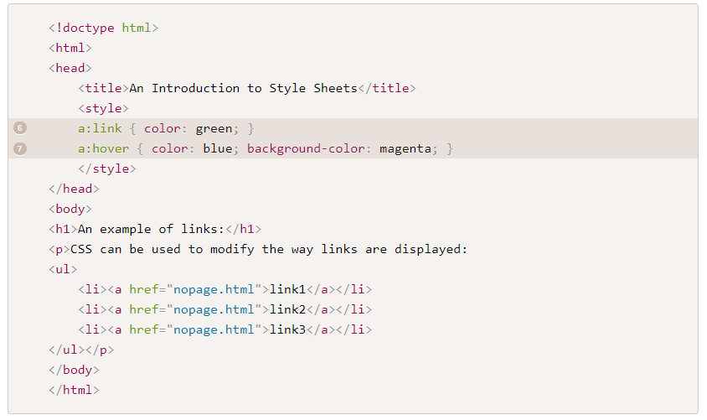
Styling Links- Example

Slide 20
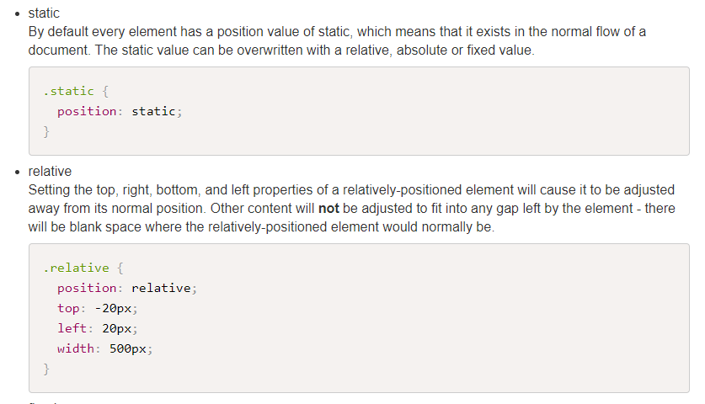
CSS Positioning
The position property identifies how an element is positioned on a page.

Slide 21
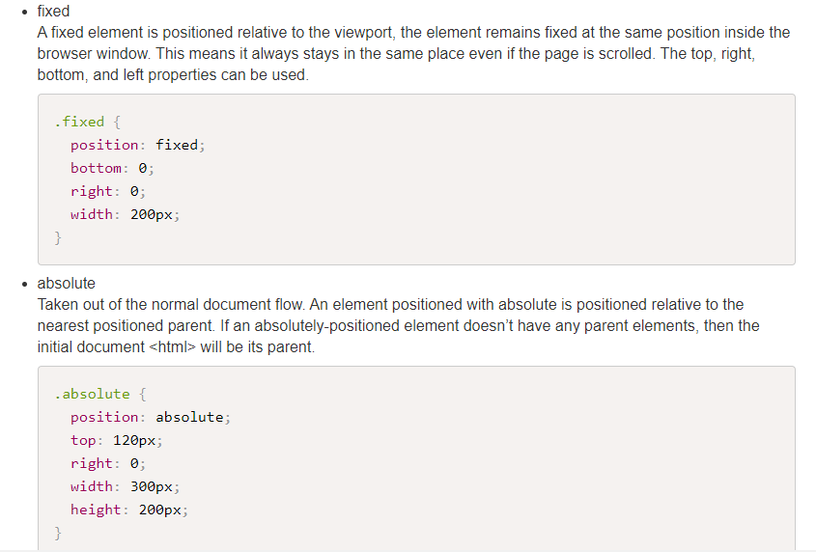
CSS Positioning

Slide 22
Float and Layout
When using CSS float for layouts it is common to float a block-level element such as <div> (or one of the HTML5 new elements like article, section, aside).
The floated elements will require a width.
Use CSSpoistioning.html file for demonstration
Layout approaches:
using percentages for the widths creates a fluid (or liquid) layout that shrinks and expands depending on the size of the browser window.
fixed layouts use pixel-based widths - the layout does not change when viewed on smaller/larger devices.

Slide 23
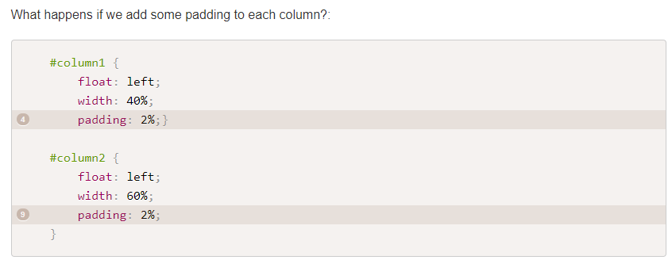
Contd

Slide 24
Contd
Example shows float drop - one column has dropped down. Why – because there is not enough room for the column. Note: the width of an element displayed in the browser window is not the same as its width property.
The displayed width of any element is a combination of its width, left and right border sizes, left and right padding and left and right margins.
Width of Column 1 = 40% plus left padding (2%) plus right padding (2%) = 44%
Width of Column 2 = 60% plus left padding (2%) plus right padding (2%) = 64%

Slide 25

Solutions
Solution 1 - Reduce column widths:
Column 1 = 36% plus left padding (2%) plus right padding (2%) = 40%
Column 2 = 56% plus left padding (2%) plus right padding (2%) = 60%
Solution 2 - Use CSS3 box-sizing property.
This includes the width and any paddings and borders within the width of the column (reduces the column width). Need prefix for Firefox.

Slide 26
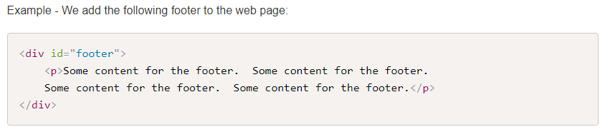
CSS clear property
As we know, with CSS float an element can be pushed to the left or right, allowing other elements to wrap around it.
The CSS clear property instructs an element to not wrap around a floated element. By clearing an element you can force it to drop down below the floated item.
You have three options - clear:left; clear:right; clear:both.
Many people choose to use clear:both since it clears elements floated left and/or right.

Slide 27
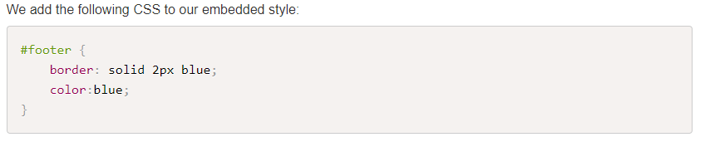
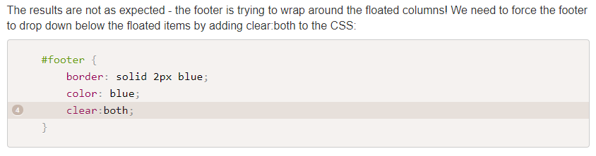
Contd

